Slide 1
Text Mining, Information and Fact Extraction
Part 5: Integration in Information Retrieval
Marie-Francine Moens
Department of Computer Science
Katholieke Universiteit Leuven, Belgium sien.moens@cs.kuleuven.be

Slide 2
Information retrieval
Information retrieval (IR) =
  representation, storage and organization of information items in databases or repositories and their retrieval according to an information need
Information items:
  format of text, image, video, audio, ...
    e.g., news stories, e-mails, web pages, photographs, music, statistical data, biomedical data, ...
Information need:
  format of text, image, video, audio, ...
    e.g., search terms, natural language question or statement, photo, melody, ...

Slide 3
Is IR needed? Yes
Large document repositories (archives):
  of companies: e.g., technical documentation, news archives
  of governments: e.g., documentation, regulations, laws
  of schools, museums: e.g., learning material
  of scientific information: e.g., biomedical articles
  on hard disk: e.g., e-mails, files
  of police and intelligence information: e.g., reports, e-mails, taped conversations
  accessible via P2P networks on the Internet
  accessible via the World Wide Web
  ...

Slide 4
Information retrieval process
Classical information retrieval system: 3 steps:
  generation of a representation of the content of each information item
  generation of a representation of the content of the information need of user
  the two representations are compared in order to select items that best suit the need
step 1: usually performed before the actual querying
steps 2 and 3 : performed at query time

Slide 5
Classical retrieval system
Information
need
Index
generation
Formulation = q
q
I
Relevant documents
Ranking(q,I)

Slide 6
Information retrieval process
Current retrieval systems
  information need expressed as:
    keywords
    query by example
    question in natural language
  Results expressed as:
    list of documents
    clusters of documents and visualization of topics
    short answer to natural language question
Variant: navigation via linked content
Future: exploration and synthesis

Slide 7
Question answering system
Information need
Index
generation
Formulation=question
q
I
Answer
Ranking(q,I)
Ranking (q,S_{i})
S₁
...
S_{n}

Slide 8
Navigation
Information
need
Relevant document(s)

Slide 9
Example of assisting tasks
Information
need
Information extraction
Contextual profiling
Text categorization
Information extraction
Index
generation
Formulation=q
q
I
Relevant documents
Ranking(q,I)
Relevant summary(ies)
Text clustering

Slide 10
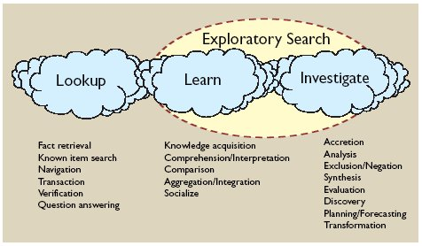
Exploration
[Marchionini ACM 2006]

Slide 11
Why interest in information extraction?
IR and IE are both established disciplines
Why this interest now?
  Catalysts:
    Question answering
    Multimedia recognition and retrieval
    Exploratory search

Slide 12
Overview
Integration in retrieval models:
  Language model
  Entity retrieval
  Bayesian network
  Question answering
Exploratory search
Interesting research avenues

Slide 13
Information retrieval models (also called ranking or relevance models)
  defined by :
        the form used in representing document text and query
        by the ranking procedure
  examples are Boolean, vector space, probabilistic models
    probabilistic models incorporate:
        element of uncertainty

Slide 14
Probabilistic retrieval model
Probabilistic retrieval model views retrieval as a problem of estimating the probability of relevance given a query, document, collection, ...
Aims at ranking the retrieved documents in decreasing order of this probability
Examples:
    language model
    inference network model

Slide 15
Generative relevance models
Random variables:
  D = document
  Q = query
  R = relevance: R = r (relevant) or R = (not relevant)
Basic question:
  estimating:
[Robertson & Sparck Jones JASIS 1976]
[Lafferty & Zhai 2003]

Slide 16
Generative relevance models
Generative relevance model:
is not estimated directly, but is estimated indirectly via Bayes’ rule:
equivalently, we may use the log-odds to rank documents:

Slide 17
Language model
[Lafferty & Zhai 2003]
is factored as
by applying the chain rule leading to the following log-odds ratios:
Bayes’rule and removal of terms for the purpose of ranking

Slide 18
Language model
The latter term is dependent on D, but independent on Q, thus can be considered for the purpose of ranking.
Assume that conditioned on the event , the document D is independent of the query Q , i.e.,

Slide 19
Language model
Assume that D and R are independent, i.e.,

Slide 20
Language model
Each query is made of m attributes (e.g., n-grams): Q = (Q₁,…,Q_{m}), typically the query terms, assuming that the attributes are independent given the document and R:
Strictly LM assumes that there is just one document that generates the query and that the user knows (or correctly guesses) something about this document

Slide 21
Language model
In retrieval there are usually many relevant documents:
  language model in practical retrieval:
  takes each document d_{j} using its individual model P(q_{i}|D), computes how likely this document generated the request by assuming that the query terms q_{i} are conditionally independent given the document
  -> ranking !
  needed: smoothing of the probabilities = reevaluating the probabilities: assign some non-zero probability to query terms that do not occur in the document

Slide 22
Language model
A language retrieval model ranks a document (or information object) D according to the probability that the document generates the query (i.e., P(Q|D))
Suppose the query Q is composed of m query terms q_{i}:
where C = document collection
λ = Jelenik-Mercer smoothing parameter
(other smoothing methods possible: e.g., Dirichlet prior)

Slide 23
Language model
P(q_{i}|D) = can be estimated as the term frequency of q_{i} in d_{j} upon the sum of term frequencies of each term in D
P(q_{i}|C) = can be estimated as the number of documents in which q_{i} occurs upon the sum of the number of documents in which each term occurs
Value of λ is obtained from a sample collection:
  set empirically
  estimated by the EM (expectation maximization) algorithm
  often for each query term a λ_{i} is estimated denoting the importance of each query term, e.g. with the EM algorithm and relevance feedback

Slide 24
Language model
The EM-algorithm iteratively maximizes the probability of the query given r relevant documents Rd₁,…,Rd_{r}:
  init (e.g.: 0.5)
  E-step:
  M-step:
Each iteration p estimates a new value by first computing the E-step and then the M-step until the value
is not anymore significantly different from

Slide 25
Language model
Allows integrating the translation of a certain content pattern into a conceptual term and the probability of this translation:
where cq_{i} = conceptual terms
w_{l} = content pattern (e.g., word, image pattern)
Possibility of building a language model for the query (e.g., based on relevant documents or on concepts of a user’s profile)

Slide 26
Language model
Integration of pLSA or LDA in language model:
where
  computed with latent topic model
  and K = number of topics (a priori defined)

Slide 27
Language model
Integrating structural information from XML document
Computing the relevance of an article X nested in a section, which on its turn is nested in a chapter of a statute:
Allows identifying small retrieval elements that are relevant for the query, while exploiting the context of the retrieval element
Cf. Cluster based retrieval models:
[Liu & Croft SIGIR 2004]

Slide 29
Language model
Advantage:
  generally better results than the classical probabilistic model
  incorporation of results of semantic processing
  incorporation of knowledge from XML-tagged structure (so-called XML-retrieval models)
Many possibilities for further development

Slide 30
Entity retrieval
Initiative for the Evaluation of XML retrieval (INEX)
Entity Ranking track:
  returning a list of entities that satisfy a topic described in natural language text
Entity Relation search:
  returning a list of two entities where each list element satisfies a relation between the two entities: “find tennis player A who won the single title of a grand slam B”

Slide 31
Entity retrieval
Goal: ranking texts (e_{i}) that describe entities for an entity search
By description ranking:
  where tf(t,e) = term frequency of t in e, |e| is the length of e in number of words, λ_{c} is a Jelenik-Mercer smoothing parameter
[Tsikika et al. INEX 2007]

Slide 32
Entity retrieval
Based on infinite random walk :
  Wikipedia texts: links
  Initialization of P₀(e) and walk: stationary probability of ending up in a certain entity is considered to be proportional to its relevance
  probability only dependent on its centrality in the walked graph
  => regular jumps to entity nodes from any node of the entity graph after which the walk restarts:
    where λ_{J} is the probability that at any step the user decides to make a jump and not to follow outgoing links anymore
    e_{i} are ranked by P∞(e) [Tsikika et al. INEX 2007]

Slide 33
Inference network model
[Turtle & Croft CJ 1992]
Example of the use of a Bayesian network in retrieval
= directed acyclic graph (DAG)
  nodes = random variables
  arcs = causal relationships between these variables
    causal relationship is represented by the edge e = (u,v) directed from each parent (tail) node u to the child (head) node v
    parents of a node are judged to be direct causes for it
    strength of causal influences are expressed by conditional probabilities
  roots = nodes without parents
    might have a prior probability: e.g., given based on domain knowledge

Slide 34
Inference network model
Document network (DAG):
  contains document representations
  document (e.g., d_{i}) represented by:
    text nodes (e.g., t_{j}), concept nodes (e.g., r_{k}), other representation nodes (e.g., representing figures, images)
  often a document network is once built for the complete document collection:
    prior probability of a document node

Slide 35
Inference network model
Query network (inverted DAG):
  single leaf: information need (Q)
  information need can have different representations (e.g., q_{i}) e.g., made up of terms or concepts (e.g., c_{l})
  a query representation can be represented by concepts
Retrieval:
  the two networks are connected e.g., by their common terms or concepts (attachment) to form the inference or causal network
  retrieval = a process of combining uncertain evidences from the network and inferring a probability or belief that a document is relevant

Slide 36
Inference network model
    for each document instantiated (e.g. d_{j} = true (=1), while remaining documents are false(= 0)): the conditional probability for each node in the network is computed
    probability is computed as the propagation of the probabilities from a document node d_{j} to the query node q
  several evidence combination methods for computing the conditional probability at a node given the parents:
    e.g., to fit the normal Boolean logic
    e.g. (weighted) sum: belief a node computed as (weighted) average probability of the parents
  documents are ranked according to their probability of relevance

Slide 37
Operators supported by the INQUERY system (University of Massachusetts Amherst, USA) :
#and : AND the terms
  #or: OR the terms
  #not: negate the term (incoming belief)
  #sum: sum of the incoming beliefs
  #wsum: weighted sum of the incoming beliefs
  #max: maximum of the incoming beliefs

Slide 38
Inference network model
[Turtle & Croft CJ 1992]
D₁
D₂
D₃
D₄
D₅
t₁
t₂
t₃
t₄
t₅
t₆
Document network
c₁
c₂
c₃
cq₁
cq₂
Query network
q₁
q₂
q₃
Q

Slide 39
Inference network model
Advantages:
  combines multiple sources of evidence and probabilistic dependencies in a very elegant way to suit the general probabilistic paradigm: e.g.,
    P(Query | Document representation, Collection representation, External knowledge,…)
  in a multimedia database easily integration of text and representations of other media or logical structure
  easy integration of linguistic data and domain knowledge
  good retrieval performance with general collections
Much new Bayesian network technology yet to be applied !

Slide 40
Question answering
Automatic question answering:
  single questions are automatically answered by using a collection of documents as the source of data for the production of the answer
  interest in the latest Text REtrieval Conferences (TREC)

Slide 41
Example:
question: “Who is the architect of the Hancock building in Boston?”
answer: “I.M. Pei”
extracted from:
“The John Hancock Tower was completed in 1976 to create additional office space for the John Hancock Life Insurance Co. It was designed by the renowned architect I.M. Pei.”
“Designed by world renowned architect I.M.Pei, the John Hancock Tower is the highest in New England.”

Slide 42
Example:
Natural language query: “Show me a video fragment where a red car takes a right turn on Saint-John’s square.”
answer:
keyframes of video fragment
extracted from:
video indexed with entities their attributes and relations including spatial and temporal relations

Slide 43
Question answering
General procedure:
1. Analysis of the question
  selection of key terms for retrieval
  identification of the question type: e.g. “Who” -> person
  linguistic analysis of the question: e.g., POS tagging, parsing, recognition of verbs and arguments, semantic role detection and named entity recognition
2. Retrieval of subset of the document collection that is thought to hold the answers and of candidate answer sentences
3. Linguistic analysis of the candidate answer sentences: cf. question

Slide 44
Question answering
General procedure:
1. Analysis of the question
  selection of key terms for retrieval
  identification of the question type: e.g. “Who” -> person
  linguistic analysis of the question: e.g., POS tagging, parsing, recognition of verbs and arguments, semantic role detection and named entity recognition
2. Retrieval of subset of the document collection that is thought to hold the answers and of candidate answer sentences
3. Linguistic analysis of the candidate answer sentences: cf. question

Slide 45
Question answering
4. Selection and ranking of answers:
  candidate sentences are scored usually based on the number of matching concepts and the resolution of an empty slot (expected answer type), namely the variable of the question
  answers can be additionally ranked by frequency
5. Possibly answer formulation

Slide 46
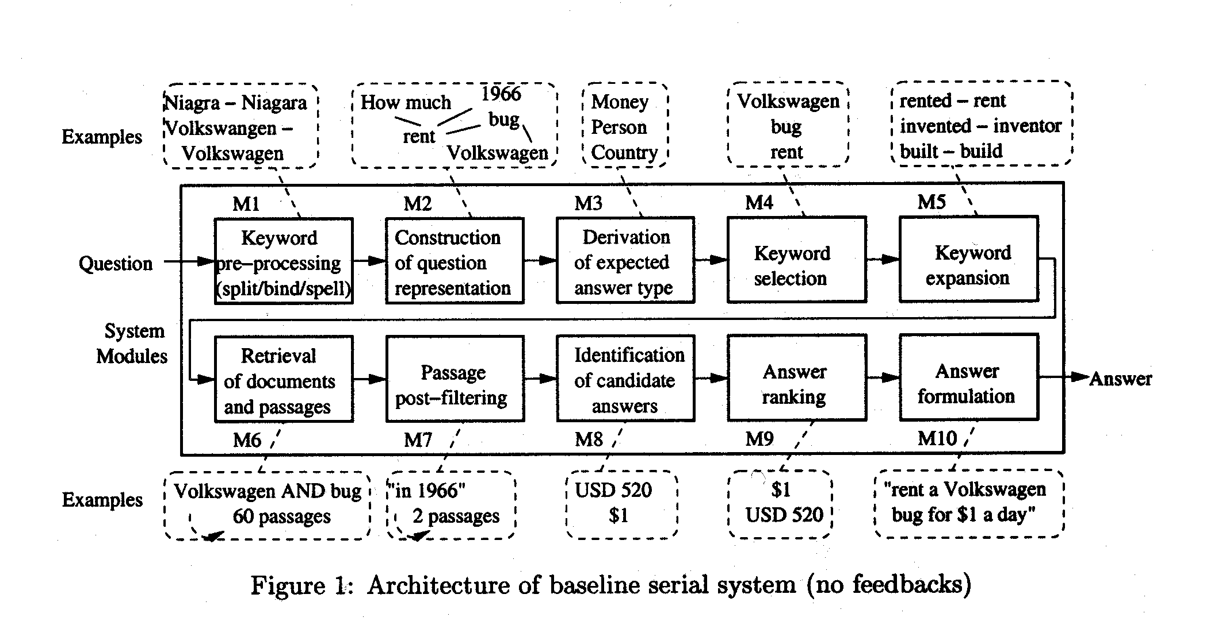
[Moldovan et al. ACL 2002]

Slide 47
Question answering
  To improve recall (e.g., no answers found):
      lexico-semantic alterations of the question based on thesauri and ontologies (e.g., WordNet)
      morpho-syntactic alterations of the query (e.g., stemming, syntactic paraphrasing based on rules)
      translation into paraphrases, paraphrase dictionary is learned from comparable corpora
      incorporation of domain or world knowledge to infer the matching between question and answer sentences

Slide 48
Question answering
To improve precision (e.g., too many answers found):
    extra constraints: extracted information (e.g., named entity classes, semantic relationships, temporal or spatial roles) from the question and answer sentence must match
    use of logical representation of question and answer sentences and logic prover selects correct answer

Slide 49
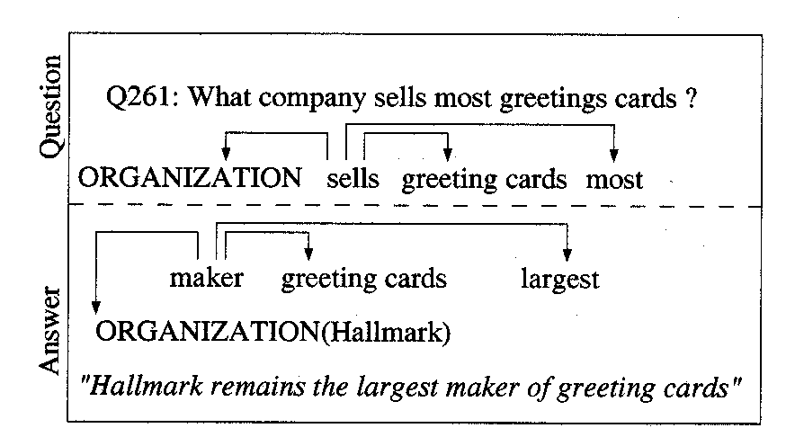
[Pasca & Harabagiu SIGIR 2001]

Slide 50
Question answering
Difficult task: requires a substantial degree of natural language understanding of the question and of the document texts
Classes of questions:
  1. Factual questions:
  -”When did Mozart die?”
  -answer verbatim in text or as morphological variation
  2. Questions that need simple reasoning techniques:
  - “How did Socrates die? “: “die” has to be linked with “drinking poisoned wine”
  -needed: ontological knowledge

Slide 51
Question answering
3. Questions that need answer fusion from different documents:
  - e.g., “In what countries occurred an earthquake last year?”
  - needed: reference resolution across multiple texts
4. Interactive QA systems:
  - interaction of the user: integration of multiple questions, referent resolution
  - interaction of the system: e.g., “What is the rotation time around the earth of a satellite? “ -> “ Which kind of satellite: GEO, MEO or LEO” ?:
    - needed: ontological knowledge
    - cf. expert system

Slide 52
Question answering
  5. Questions that need analogical reasoning:
    speculative questions: “Is the US moving towards a recession?”
    most probably the answer to such questions is not found in the texts, but an analogical situation and its outcome is found in the text
    needs extensive knowledge sources, case-based reasoning techniques, temporal, spatial and evidential reasoning
    very difficult to accomplish due to the lack of knowledge

Slide 53
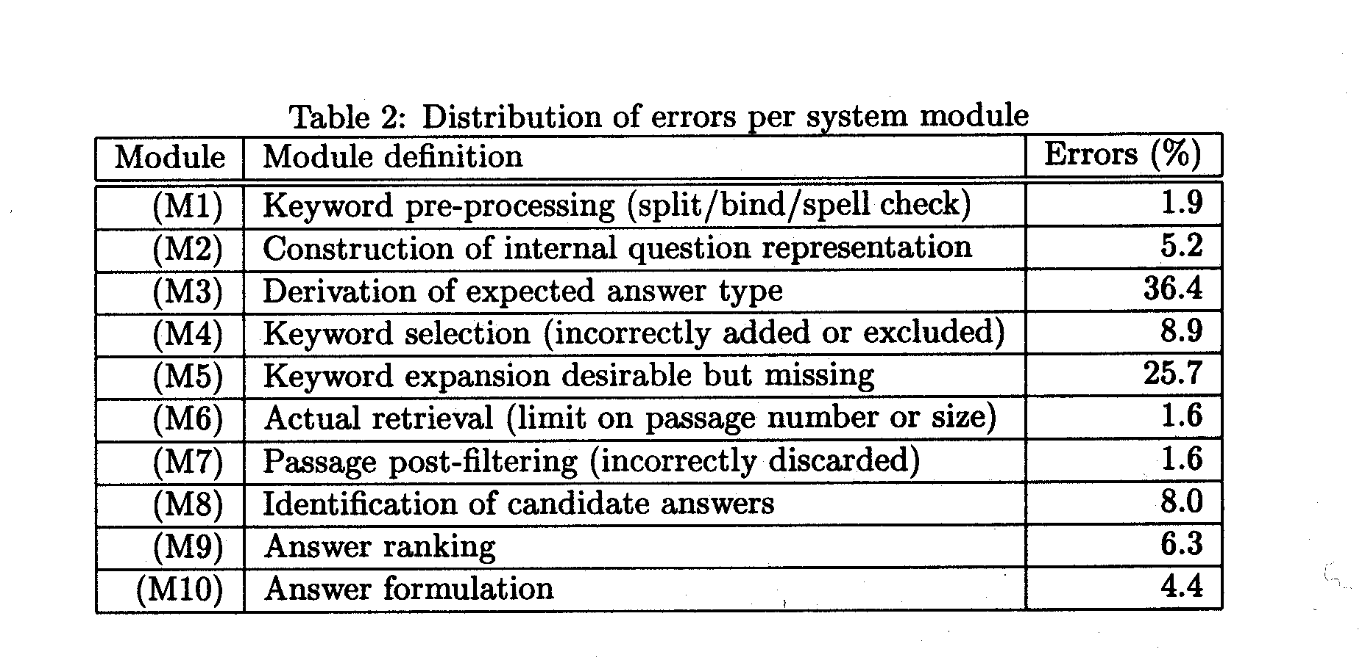
Question answering results
[Moldovan et al. ACL 2002]

Slide 54
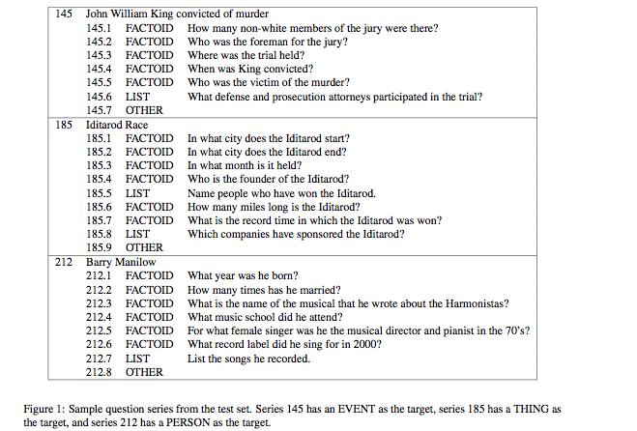
[Dang et al. TREC 2007]

Slide 55
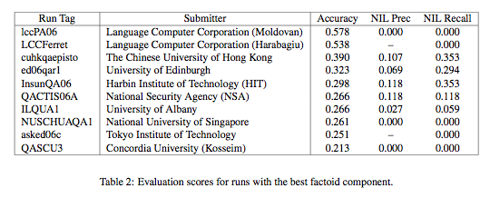
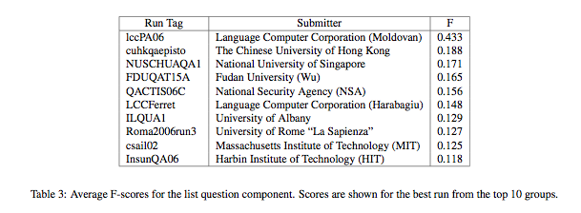
[Dang et al. TREC 2007]

Slide 56
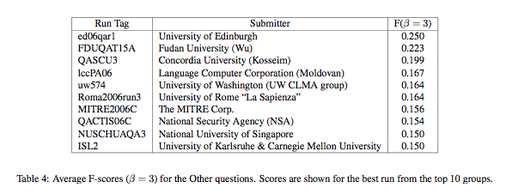
[Dang et al. TREC 2007]

Slide 57
Question answering in the future
Increased role of:
  information extraction:
    Cf. multimedia content recognition (e.g. in computer vision): information also in text will increasingly semantically be labeled
    Cf. Semantic Web
  automated reasoning (yearly KRAQ conferences):
    to infer a mapping between question and answer statement
    for temporal and spatial resolution of sentence roles

Slide 58
Reasoning in information retrieval
Logic based retrieval models:
  logical representations (e.g., first order predicate logic)
  relevance is deduced by applying inference rules
Inference networks (probabilistic reasoning)
Possibility to reason across sentences, documents, media, ...:
=> real information fusion
Scalability?
...

Slide 60
Exploratory search
Navigation, exploration, analysis of visualized information
Needed: named entity recognition, relation recognition, noun phrase coreference resolution, ...
Many applications: intelligence gathering, bioinformatics, business intelligence, ...

Slide 61
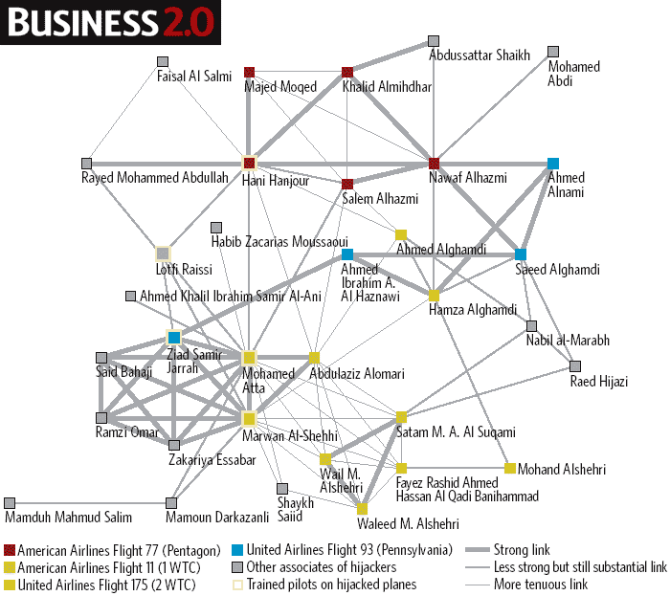
Source: COPLINK

Slide 62
We learned
The early origins of text mining, information and fact extraction and the value of these approaches
Several machine learning techniques among which context dependent classification models
Probabilistic topic models
The many applications in a variety of domains
The integration in retrieval models

Slide 63
Interesting avenues for research
Beyond fact extraction
Extraction of spatio-temporal data and their relationships
Semi-supervised approaches or other means to reduce annotation
Linking of content, cross-document, cross-language, cross-media
Integration in search
  AND MANY MORE ...

Slide 64
References
Dang H.T., Kelly, D. & Lin, J. (2007). Overview of the TREC 2007 question answering track. In Proceedings TREC 2007. NIST, USA.
Lafferty, J. & Zhai C. X. (2003). Probabilistic relevance models based on document and query generation. In W.B. Croft & J. Lafferty (Eds.), Language Modeling for Information Retrieval (pp. 1-10). Boston: Kluwer Academic Publishers.
Liu, X. & Croft, W.B. (2004). Cluster-based retrieval using language models. In Proceedings of the 27th Annual International ACM SIGIR Conference on Research and Development in Information Retrieval.
Marchionini, G. (2006). Exploratory search: from finding to understanding. Communications of the ACM, 49 (4), 41-46.
Moldovan, D. et al. (2002). Performance issues and error analysis in an open-domain question answering system. In Proceedings of the 40th Annual Meeting of the Association for Computational Linguistics (pp. 33-40). San Francisco: Morgan Kaufmann.
Pasca, M. & Harabagiu, S. (2001). High performance question answering. In Proceedings of the 24th Annual International ACM SIGIR Conference on Research and Development in Information Retrieval.
.

Slide 65
References
Robertson, S. & Sparck Jones, K. (1976). Relevance weighting of search terms. Journal of the American Society for Information Science, 27, 129-146.
Tsikrika, T., Serdyukov, P., Rode, H., Westerveld, T., Aly R., Hiemstra, D. & de Vries A.P. (2007). Structured document retrieval, multimedia retrieval, and entity ranking using PF/Tijah. In Proceedings INEX 2007.
Turtle, H.R. & Croft, W.B. (1992). A comparison of text retrieval models. The Computer Journal, 35 (3), 279-290.
Language modeling toolkit for IR: http://www-2.cs.cmu.edu/lemur/

